Slide 1
Antibiotics

Slide 2
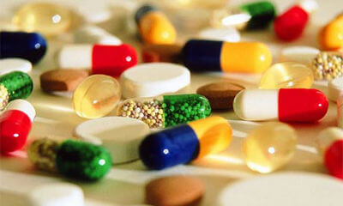
By the end of this lesson you should be able to answer the following questions:
1. | State what antibiotics are used to treat.
2. | Recall how antibiotics were discovered.
3. | Explain how antibiotics target and kill bacteria.
4. | Explain what antibiotic resistance is.

Slide 3
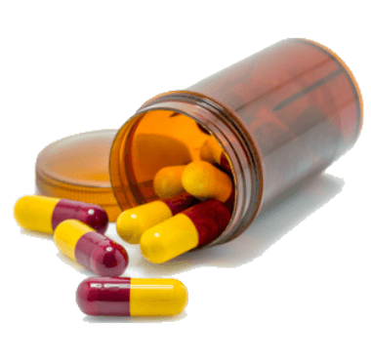
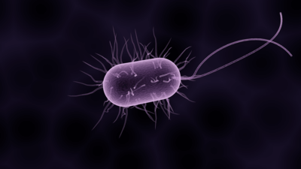
Antibiotics are a type of medicine that can stop the growth of, or kill bacteria.
This means they can be used to treat diseases caused by bacteria.
"Antibiotic" literally means "life-killing." Bacteria are alive, so antibiotics can kill them. However, viruses are not alive. Antibiotics cannot be used to treat diseases caused by viruses like the cold and the flu.

Slide 4
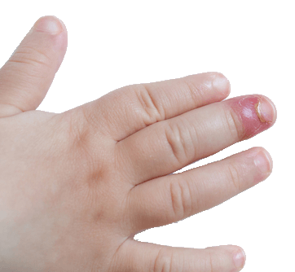
Before antibiotics were discovered, there was no way to treat bacterial infections.
You had two choices: wait and see if your body could fight off the infection; or cut the infection off your body.
This meant that even if you got a tiny paper cut on your finger and it became infected, you might lose your finger!

Slide 5
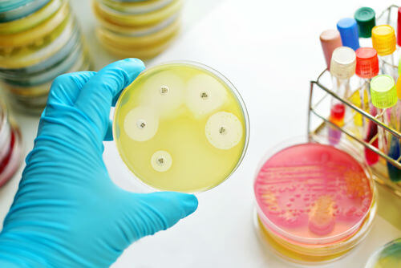
Antibiotics were first discovered in 1928 by Alexander Fleming.
He discovered them accidentally when a petri dish he had been growing Staphylococcus aureus bacteria on became contaminated with mould.
He noticed that the bacteria around the mould had been killed, thus leading to the discovery of penicillin, the first antibiotic!

Slide 6
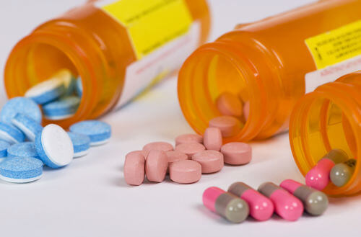
How Antibiotics Work
Antibiotics work by targeting specific regions on the bacteria which will kill or slow the growth of bacterial cells, while leaving our own body cells unharmed.
These specific structures or processes are only found in bacteria and not in human cells. This means that antibiotics will only target bacteria, and not our body cells.

Slide 7
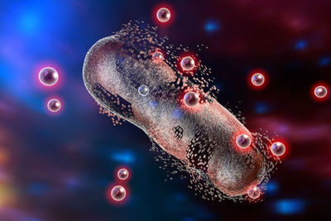
Penicillin prevents the bacterial cell wall from assembling.
For example, penicillin prevents the proper assembly of part of the bacterial cell wall. This causes the bacterial cell to burst and die, because its cell wall is so weak.
However, human cells do not have cell walls, so penicillin does not affect them.

Slide 8
Other antibiotics like tetracycline inhibit the growth or reproduction of bacteria without killing them.
Bacteria normally divide very quickly and the numbers can get out of control. These types of antibiotics stop them from growing and dividing which allows the immune system to find and destroy the bacteria.

Slide 9

Some antibiotics act against a wide range of different bacteria.
These antibiotics are often referred to as being broad spectrum.
Unfortunately, as well as killing the disease-causing bacteria, these antibiotics can also kill some of the good bacteria in our body that are vital to our health. This can cause side effects and make us feel a bit sick.

Slide 10
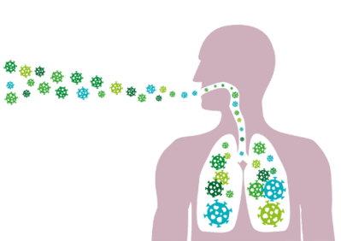
It is important to remember that antibiotics are only used to target bacterial infections.
They do not work on viruses because viruses have very different structures and mechanisms for survival than bacteria.
This is why you will only be prescribed antibiotics for bacterial infections such as pneumonia, strep throat or bladder infections, but never for viral infections like the cold or the flu.

Slide 11
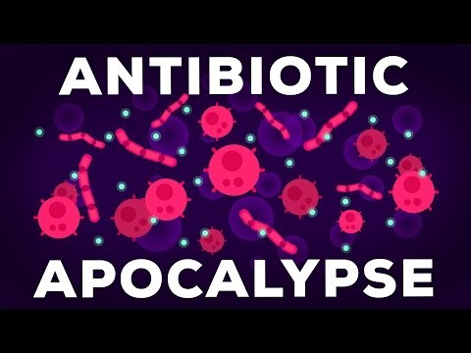

Slide 12
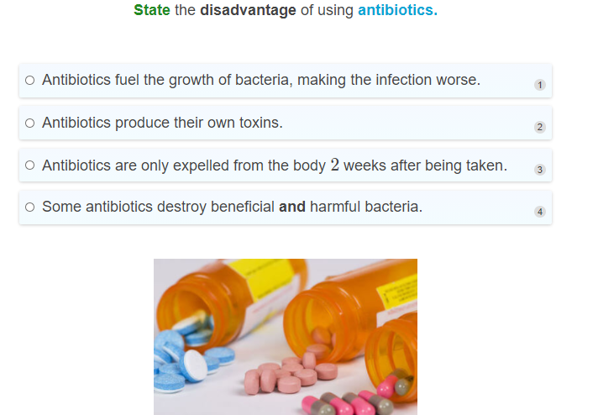

Slide 13
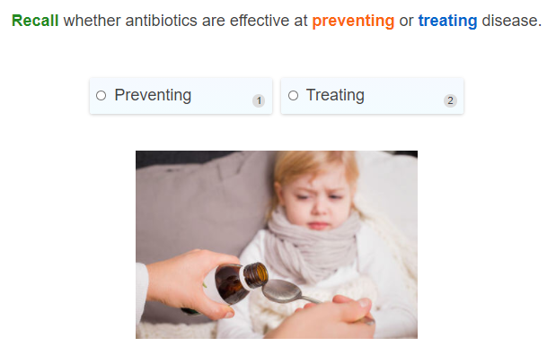

Slide 14
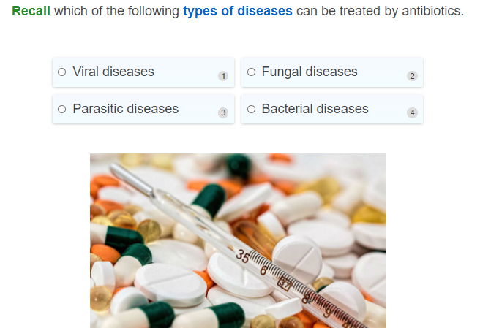

Slide 15
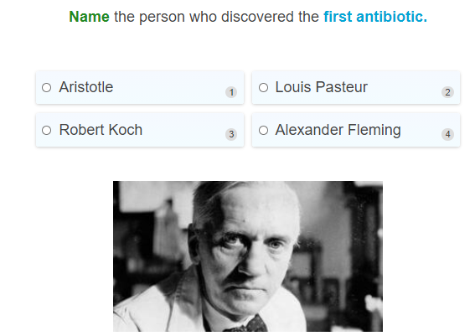

Slide 16
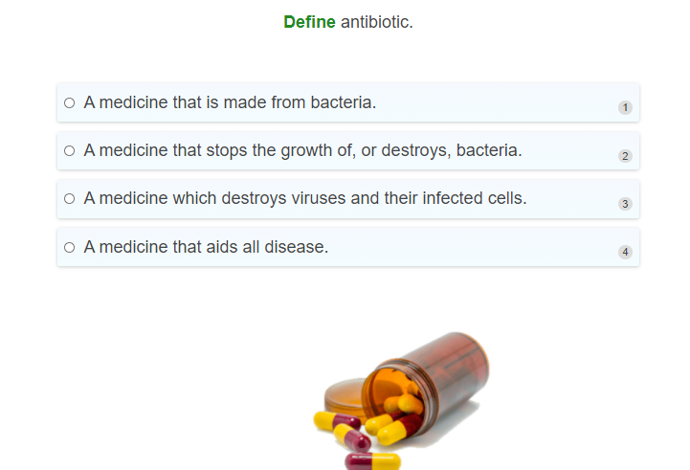

Slide 17
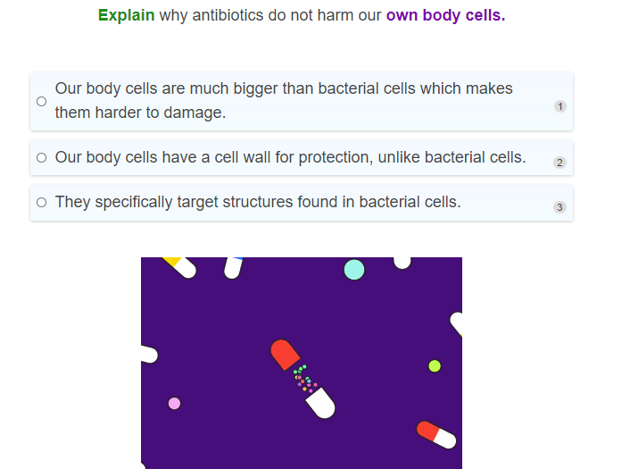

Slide 18
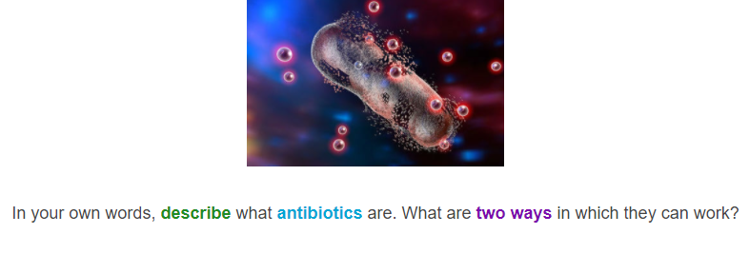

Slide 19
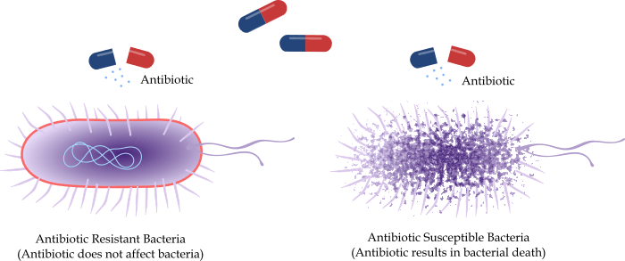
Antibiotic Resistance
Although antibiotics have prevented millions of deaths from bacterial diseases, their overuse and misuse has contributed to the serious problem of antibiotic resistance.
Antibiotic resistance occurs when some bacteria stop responding to antibiotics. This means that the antibiotic can no longer kill them, or inhibit their growth.
It occurs because bacteria have many strategies to rapidly adapt to their environment in order to survive.

Slide 20
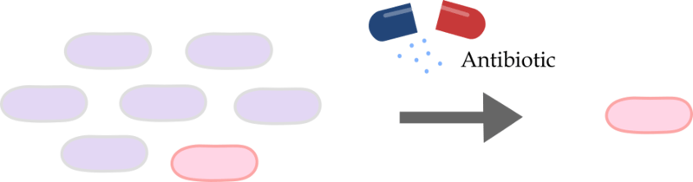
Bacteria can develop resistance in two ways - by genetic mutation or by getting resistance from another bacterium.
In a population of bacteria, some of them may develop genetic mutations that allow them to survive the application of an antibiotic. The bacteria that don't have this mutation die, leaving only the resistant bacteria behind.
Most bacteria are not resistant to the antibiotic (purple). One bacterium (pink) has developed a genetic mutation making it resistant, so it is not killed by the antibiotic.

Slide 21
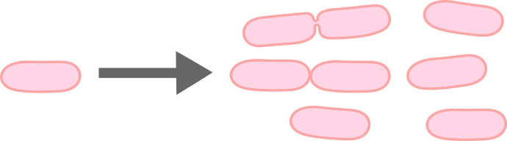
Bacteria that develop resistance go on to reproduce and produce more antibiotic resistant bacteria
The resistant bacteria then have more room and resources to rapidly reproduce, forming a new generation in which nearly all the bacteria will be resistant to the antibiotic.
Over time, the resistant genes increase in the population, forming entire strains of bacteria that are resistant to the antibiotic.

Slide 22
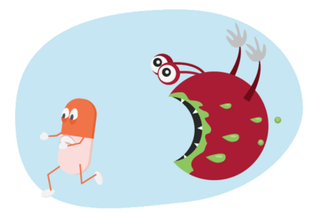
This is very bad news, because it takes a long time to develop new antibiotics, and by the time we do the bacteria may quickly become resistant to them anyway!
It means that for some diseases we are back to the old days where the only way of treating them is to wait and see if the body is able to fight it off, or remove the infected part of the body.

Slide 23
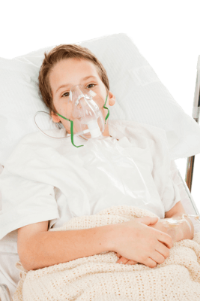
An example of an antibiotic resistant bacterium is methicillin-resistant Staphylococcus aureus, or MRSA.
MRSA cannot be treated with traditional antibiotics, and therefore it is much more dangerous than other bacterial infections. MRSA infections can be very serious and even fatal, especially because they usually occur in hospitals where people are more vulnerable to infection.

Slide 24

There are some ways you can help reduce the chances of antibiotic resistant bacteria developing.
Firstly, only take antibiotics when you really need them. Never take them unless your doctor has prescribed them to you.
Your doctor will know whether or not the disease you have requires antibiotic treatment.

Slide 25
You should also take your antibiotics exactly as your doctor prescribes them.
Do not skip any doses, and complete the full course of treatment even if you begin to feel better.
If you stop taking the antibiotics too early, it can promote the growth of antibiotic resistant bacteria.

Slide 26
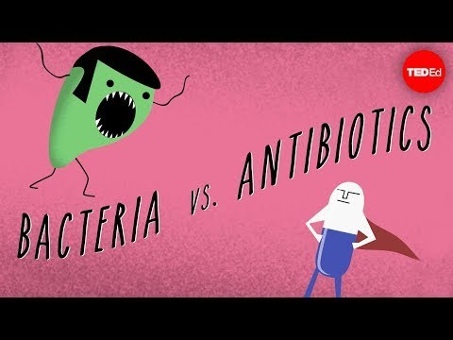

Slide 27
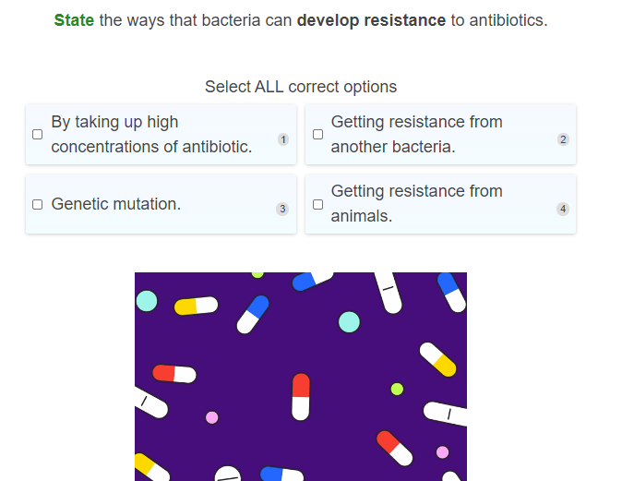

Slide 28
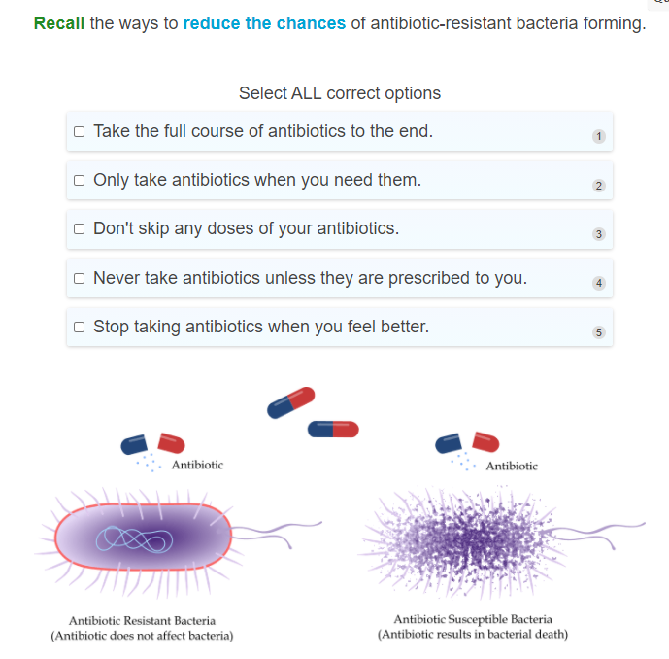

Slide 29
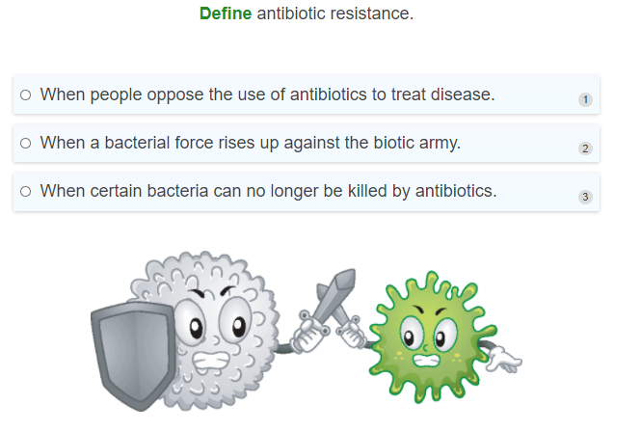

Slide 30
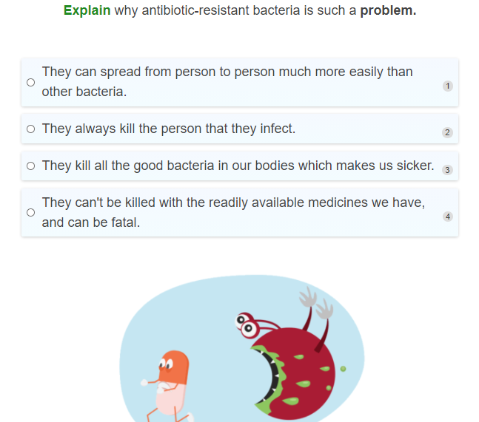

Slide 31
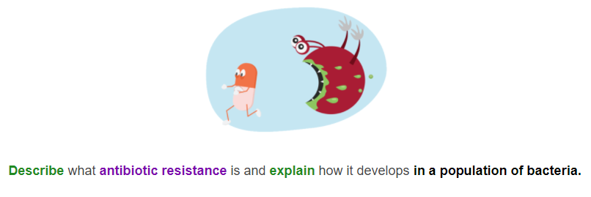

Slide 32
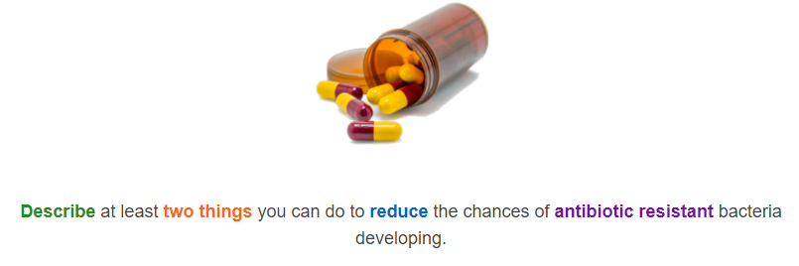

Slide 33
